Slide 1
Chi-Squared tests (χ²)

Slide 2
Definition
The Chi-square test measures the association between two or more variables.

Slide 3
Data needed
designed to analyze categorical data. (male female, Pass fail) ie., nominal
Not continuous data (such as height in inches, marks).
Notes:
CONTINUOUS DATA TO CATEGORICAL DATA - if you want to test whether attending class influences how students perform on an exam, using test scores (from 0-100) as data would not be appropriate for a Chi-square test. However, arranging students into the categories "Pass" and "Fail" would. Additionally, the data in a Chi-square grid should not be in the form of percentages, or anything other than frequency (count) data. Thus, by dividing a class of 54 into groups according to whether they attended class and whether they passed the exam

Slide 4
Cross-tabulation of more than two variables
Possible to have more than two variables in a table.
Difficult to assimilate the information
Use only if it likely to help in the analysis and to draw useful conclusion

Slide 5
Lack of casual inference in cross-tabulation
Any two variables can be cross-tabulated.
Significant association between the two variables, not necessarily mean that one of them (independent) causes the other (dependent).

Slide 6
Calculate Expected Value
The formula is
O is observed frequency
E is Expected frequency
Expected frequency for each category is calculated as follows
total no.observations / number of categories
E i j = ( row total i × column total j) / n
n is the total number of observations

Slide 7
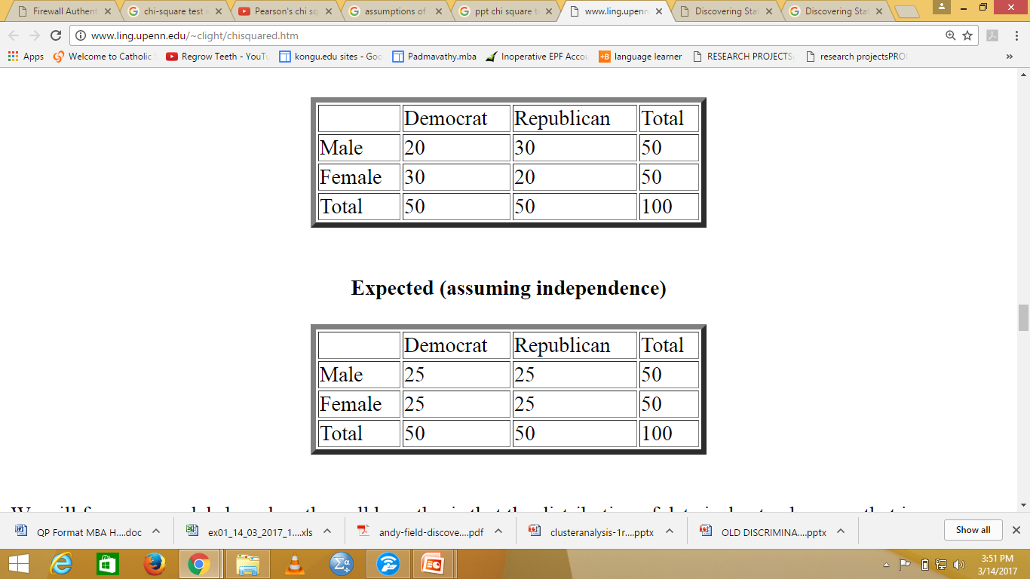
observed

Slide 8
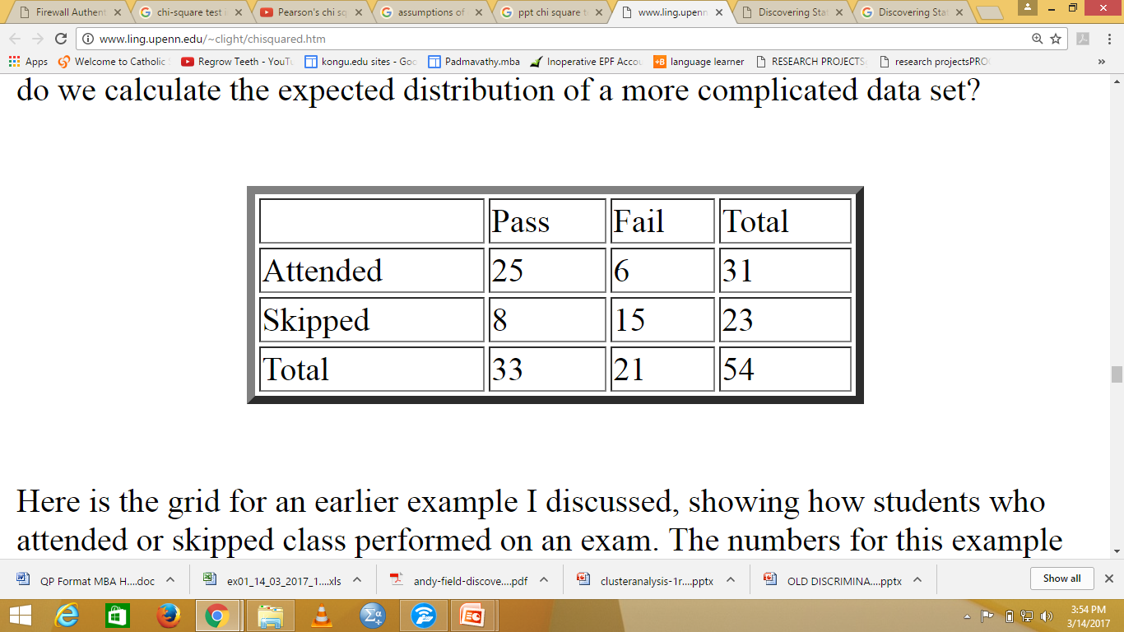
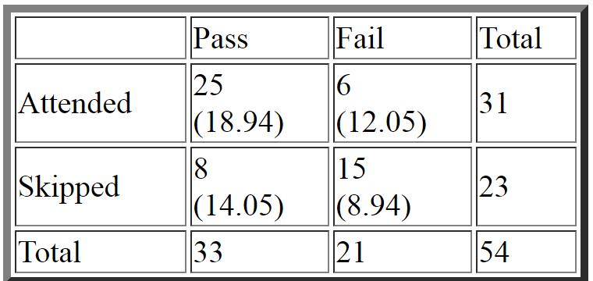
Notes:
(RowTotal*ColTotal)/GridTotal
For cell (1,1) it is (33*31)/54, or 18.94. (33*23)/54

Slide 9
Degrees of freedom
equations would be used to calculate the degrees of freedom
(no. of rows - 1) * (no. of columns - 1).
(r-1) x (c-1)
Notes:
In statistics, the number of degrees of freedom is the number of values in the final calculation of a statistic that are free to vary. The number of independent ways by which a dynamic system can move, without violating any constraint imposed on it, is called number of degrees of freedom

Slide 10
chi square is…
Testing Goodness of Fit
The Chi-square test is intended to test how likely it is that an observed distribution is due to chance.
Chi Square distribution to test the difference between theoretically expected and observed frequencies
Test of association/ relationship
To test the relationship/ association between nominal variables for significance

Slide 11
Assumptions of the Chi-Square test:
1. Observations must be independent: each subject must contribute to one and only one category. Otherwise the test results are completely invalid.
2. Problems arise when expected frequencies are very small. Chi-Square should not be used if more than 20% of the expected frequencies have a value of less than 5. (It does not matter what the observed frequencies are).
To overcome less expected value: combine some categories (if this is meaningful in your experiment), OR obtain more data (make the sample size bigger).

Slide 12
OBJECTIVE Whether Educational qualification influences Psychological wellbeing?
3. Educational Qualification of the respondent
a) Schooling b) Diploma c) UG d)PG
Psychological Wellbeing - PC1 [ Mean of Psychological wellbeing is recoded as “LOW” and “ High” ]
Whether a nominal(any level) influences a nominal(any level)?
Chi square test (or) Test of association

Slide 13
Hypothesis
H0: There is no significant association among Education qualification and psychological wellbeing.
H1: There is a significant association among Education qualification and psychological wellbeing
To check whether Education qualification influences psychological wellbeing of the employees

Slide 14
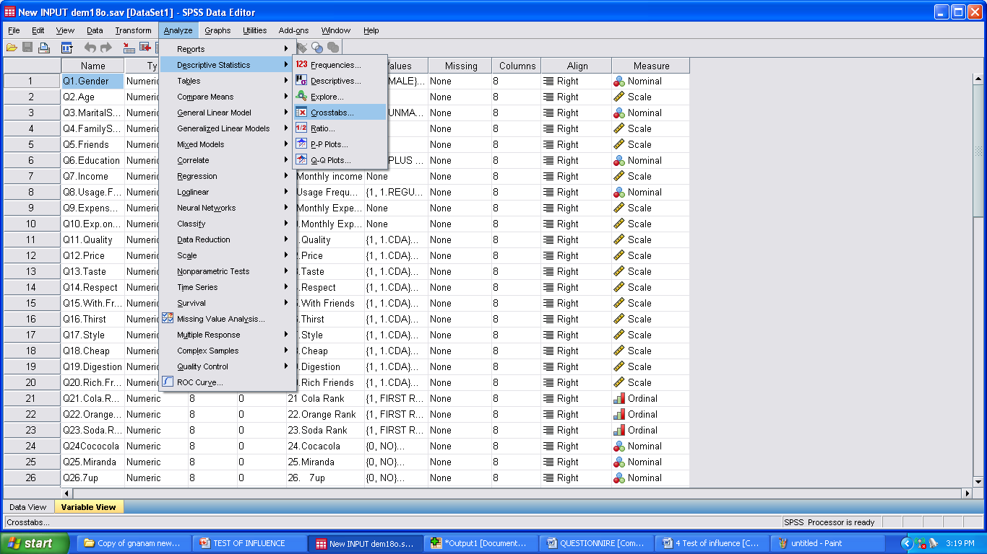
1)Analyze > Descriptive statistics > Cross tab

Slide 15
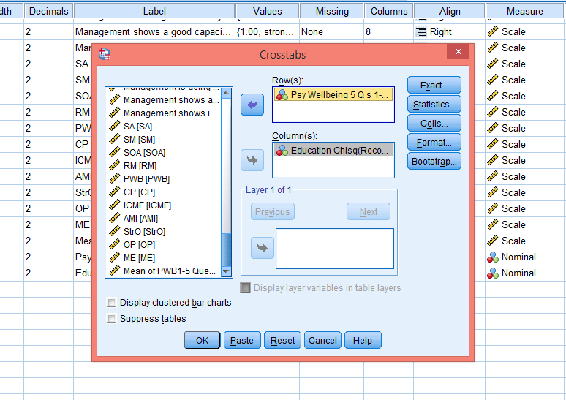
2) Transfer.. Influencing variable( Education qualification Chi-square ) to Column. Influenced variable(PC1 – Psyco Wellbeing) to Row.

Slide 16
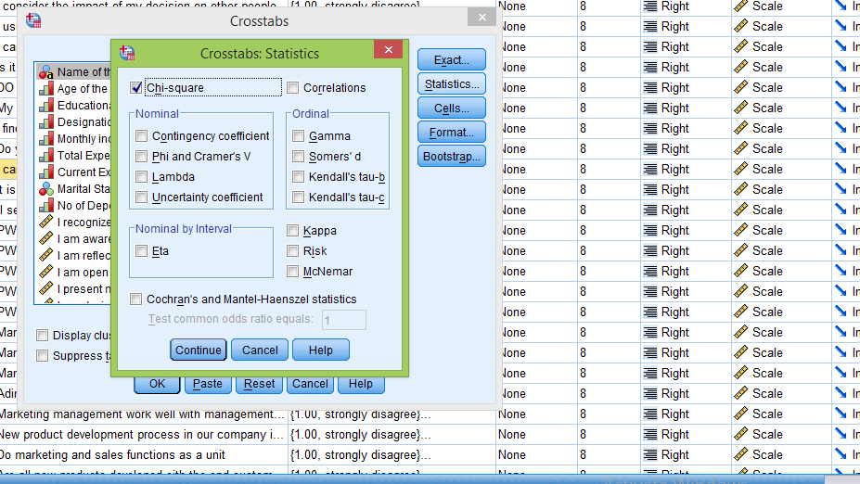
3)Click…Statistics > pop up appears… click…Chi square > Continue

Slide 17
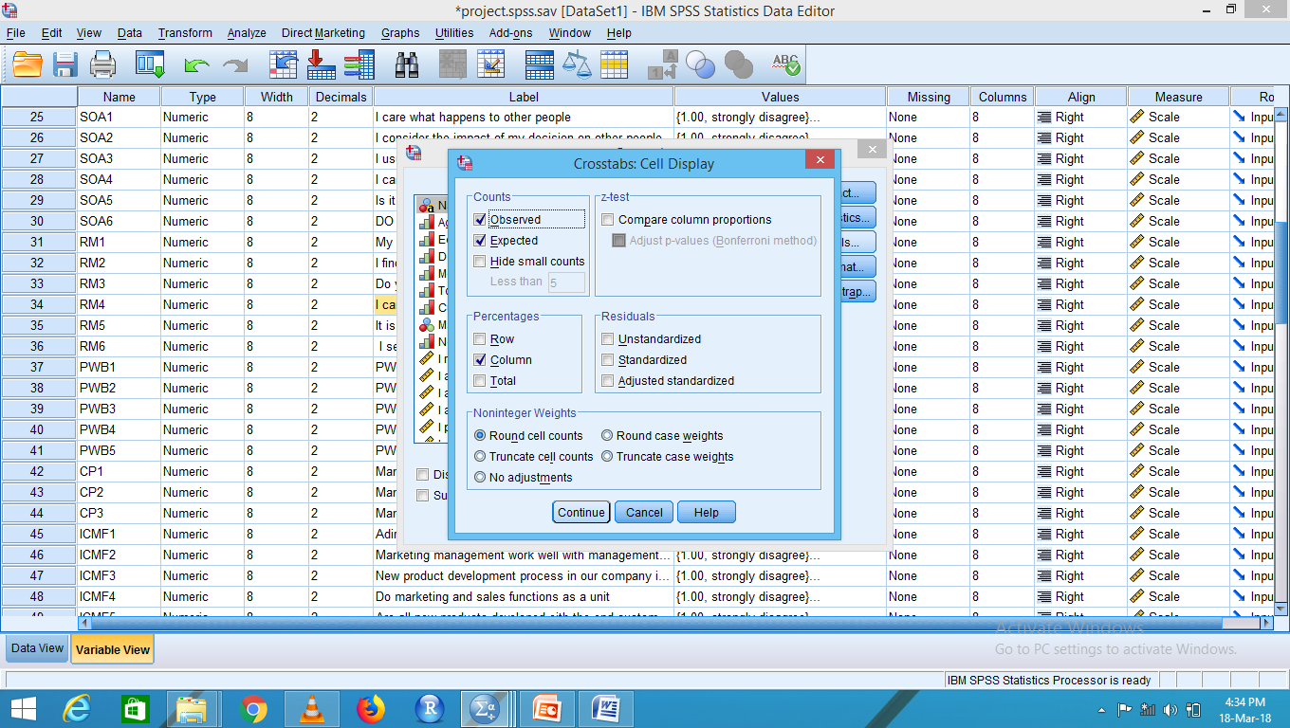
4)click..Cells > pop up appears.. Click…column > continue >ok

Slide 18
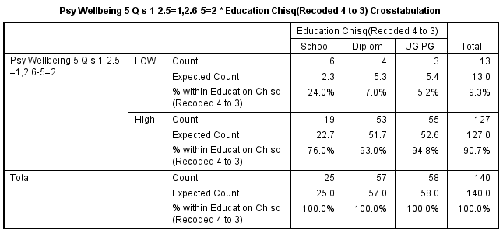
OUTPUT
The psychological wellbeing is high among the graduates and the diploma than the school level education qualification

Slide 19
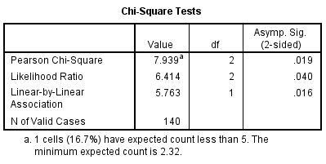
p value is 0.019 . – which is < 0.05.
So Educational Qualification and Psychological wellbeing are related. Educational Qualification influences Psychological wellbeing

Slide 20
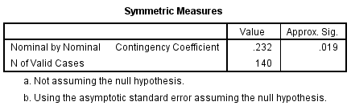
To measure the strength of the association between the two variables in the cross tab
The value is 0.232 which is less
So Educational Qualification and Psychological wellbeing are related.
Refer lambda if it is a 2 x 2 matrix. Lesser lambda value – variables are related.

Slide 21
Chi-square in R
net<-read.csv("project.csv")
View(net)
b<-table(net$Education,net$pc1)
b
chisq.test(b)$expected
chisq.test(b,correct = F)

Slide 22
Why you should avoid using Chi-Square if you can:
Design studies so that you can avoid using Chi-square!
Frequency data give little information about participants' performance: all you have is knowledge about which category someone is in, a very crude measure.
It's much more informative to obtain one or more scores per participant; scores give you more information about performance than categorical data (and can be used with better statistical tests).
e.g. IQ: which is better - to know participants are “bright” or “dim”, or have their actual IQ scores?

Slide 23
Reference
http://www.basic.northwestern.edu/statguidefiles/gf-dist_ass_viol.html
http://www.ling.upenn.edu/~clight/chisquared.htm
https://onlinecourses.science.psu.edu/stat200/node/186

Slide 24
Thank You

